Slide 1
East African Cybersecurity
Improving Microfinance Database in Ethiopia
Group members:
Ishan Prabhune
Harshal Sawant
Pratik darade
Raj Dedhia
Aniket Singh

Slide 2
Introduction
Welcome to our comprehensive exploration of the initiatives aimed at improving microfinance in the diverse nation of Ethiopia. The Ethiopian government has identified microfinance institutions (MFIs) as priority institutions as a part of strategies for poverty reduction and development programs.
In this presentation, we'll take a closer look at Metemamen Microfinance Institution (MMFI) and its vital role in addressing financial challenges faced by both urban and rural populations. We'll delve into the significance of microfinance as a pivotal instrument in Ethiopia's strategies for poverty reduction and development programs and their importance in poverty reduction and economic development.

Slide 3

Regional Importance
Ethiopia, one of Africa’s largest nations both in geographical size and population, stands as one of the largest countries in Africa. It covers an expansive landmass and is home to over 110 million people, making it the second most populous nation on the continent.
Addis Ababa, the capital city of Ethiopia, holds a central role in the nation's education, administration, and cultural heritage. It hosts renowned institutions like Addis Ababa University, the Museum of the Institute of Ethiopian Studies, and the National Library and Archives.
Addis Ababa is also honored to be the headquarters of the African Union (AU). This continental union, representing 55 member states across Africa, is dedicated to fostering the growth and economic development of the continent.
Agriculture plays a pivotal role in Ethiopia's economy, employing over 70% of the population. However, it's important to note the ongoing migration of youth from rural areas to urban centers, driven by the pursuit of diverse opportunities.

Slide 4
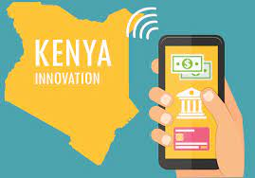
National Security Implications
In neighboring Kenya, a groundbreaking mobile payment system known as M-Pesa emerged in the mid-2000s. M-Pesa, a mobile phone-based money transfer system, microfinancing service, and payment platform, revolutionized financial transactions. Kenyans now have the ability to send money to each other via simple text messages on their mobile devices, a practice that has streamlined transactions, even in remote regions.
The impact of M-Pesa extends far beyond convenience; it has led to remarkable changes in various sectors. For instance, women engaged in the fishing industry on Lake Victoria have experienced transformative effects on their financial operations, thanks to this cashless payment system.
These developments in Kenya have inspired Ethiopia to explore the adoption of mobile payment systems and other technologies to enhance service delivery to its citizens. This sets the stage for a potential revolution in the delivery of financial services in Ethiopia.

Slide 5

Microfinance Institutions
Buusaa Gonofaa Microfinance Institution (BGMFI), a licensed microfinance organization based in Ethiopia and supervised by the National Bank of Ethiopia. Established in 1999, BGMFI has a clear mission: to support women, farmers, and youth who do not possess land, granting them greater economic access.
BGMFI envisions the creation of an inclusive, efficient, and mature financial system accessible to all segments of the population. By offering credit, savings, and other financial services, BGMFI seeks to improve the livelihoods of approximately 100,000 clients.
The implementation of a microfinance system of this nature holds the promise of several positive outcomes. It provides women with the means to safeguard their finances, reduces concerns about spouses misusing funds, and ensures the safekeeping of money, protecting it from potential theft which happened a lot before. Moreover, the expedited distribution of loans is another crucial advantage. It ensures that funds are available for farmers at the right time, particularly during planting seasons, eliminating the need to wait for weeks or even months.

Slide 6

Project Overview
While Ethiopia has shown substantial economic growth and a rising demand for financial services, its institutional banking system faces notable challenges. In this context, MMFI is exploring the adoption of mobile banking technologies to enhance customer service and facilitate financial inclusion.
The core value of mobile banking technologies lies in their capacity to promote financial inclusion. These technologies enable rural farmers to access loans, transfer money, and check their bank accounts from the comfort of their homes. This proposition not only attracts new clients but also expands the customer base of MMFI, ultimately leading to a reduction in administrative and operational costs associated with opening and managing new branch offices.

Slide 7
Problem Statement
To address the unique challenges faced by Metemamen Microfinance Institution (MMFI), our researchers collaborated closely with key stakeholders from Catholic Relief Services (CRS) and BGMFI. This fruitful collaboration led to the formulation of solutions tailored to the organization's specific needs.
The project encompassed four major components. Firstly, a comprehensive evaluation with a scope extending over five years was planned. This long-term perspective allowed for a more in-depth analysis of the challenges and their solutions.
Secondly, the researchers provided a high-level design for the database infrastructure. A robust database infrastructure is essential for the efficient and secure management of financial data.
The third aspect involved a review of a Point of Sale (POS) application designed for use with mobile devices. Such an application is crucial for enhancing the client's experience and enabling convenient financial transactions.
Finally, the project presented a proposal containing solutions aimed at mitigating the challenges associated with database integration. As MMFI sought to enhance its mobile banking capabilities, addressing these integration hurdles was a priority.

Slide 8
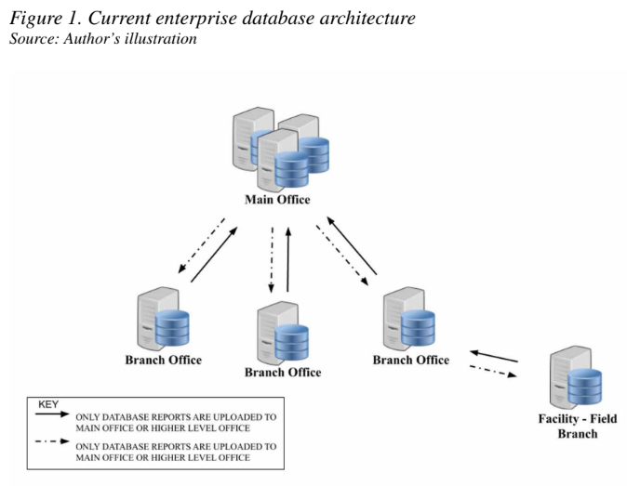
Problem Discovery
During the initial assessment, it became evident that MMFI faced significant challenges, particularly concerning its workforce. The organization struggled with limited staff resources, hindering their ability to address the issues identified. This required the engagement of external consultants to rectify database errors.
Currently, MMFI exports data to .csv files, which are then handed over to a company based in Southeast Asia. This external company runs a tool to validate the data and ensure the accuracy of the information. At present, more than 30 issues have been identified, and the cost of this validation process becomes a substantial expense.

Slide 9
This software-driven data check is estimated to take about 1.5 hours per activity, costing approximately $1350. When converted to Ethiopian Birr, this amounts to around 36,909 ETB per activity. Such costs pose challenges in budgeting for MMFI's overall projects and data migration.
Another issue arises in the transport of data from remote sites to the headquarters in Addis Ababa. Due to slow Internet speeds, employees often need to travel for up to four hours to deliver data in person. This data is transported on an unencrypted Universal Serial Bus (USB), which has led to instances of misplaced USBs during trips.
In light of growing concerns about privacy and security in the region, maintaining the confidentiality and integrity of communication becomes paramount. Data transferred in plain text is vulnerable to interception and modification, posing risks to personal identifiable information (PII) and sensitive financial data.

Slide 10
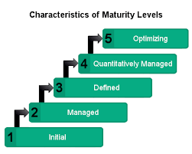
Need for Process Implementaion
One critical challenge was the absence of established processes within the organization. The Capability Maturity Model Index (CMMI) was recommended to introduce repeatability and ensure standardized processes and best practices.
Testing components and code reviews became essential to verify the integration of new modules into the system. Ensuring the robustness of each component, as well as integration testing, is critical for avoiding vulnerabilities and ensuring the system's reliability.
Effective planning was another challenge; the absence of performance indicators, action plans to elevate the organization's position, and clear goal placements hindered progress. Planning processes need to encompass these aspects for success.

Slide 11
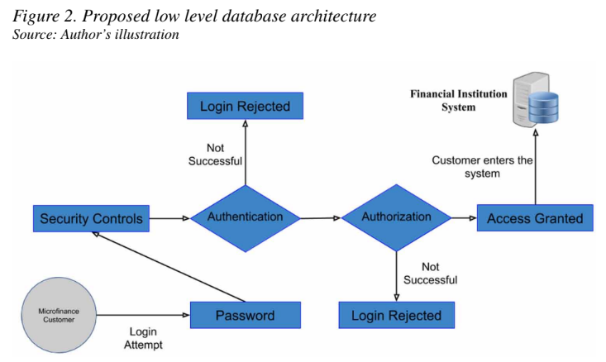

Project Recommendations – Documentation Management
System's Documentation Management:
The researchers recommended the implementation of a robust system for managing the organization's documentation. OpenKM, a versatile platform, was identified for its capacity to meet document management, collaboration, and advanced search needs.
Enhanced Administrative Tools:
OpenKM offers administrative tools for defining user roles, access control, user quotas, detailed activity logs, and automation setup. This centralized platform can hold enterprise content collected from diverse digital sources, thereby improving decision efficiency, employee productivity, customer relations, and sales cycles.

Slide 12



Project Recommendation – Secure Email and Data Encryption
Strengthening Email Security:
To enhance the availability, integrity, and confidentiality of communication within the organization, the researchers recommended transitioning to a more secure email client, Thunderbird. Thunderbird can incorporate Internet Message Access Protocol (IMAP) synchronization with the Google ecosystem and implement encryption for sensitive emails through Enigmail.
Data Encryption at Rest:
Given the sensitivity of the information possessed by the organization, encryption of data at rest was deemed necessary. VeraCrypt, an open-source solution, offers multiple options for data encryption, including creating virtual encrypted disks and encrypting entire storage devices with pre-boot authentication

Slide 13

Security and Privacy Controls
NIST 800-53 controls, outlined in the National Institute of Standards and Technology's Special Publication 800-53, serve as a comprehensive framework for cybersecurity. These controls cover various aspects crucial for a robust security posture.
Specific Controls recommended for implementation:
Access control ensures authorized user access.
Awareness and training focus on educating personnel about security threats.
Audit and accountability involve regular assessments and documentation.
Configuration management maintains system integrity through structured changes.
Incident response outlines procedures for handling security incidents.

Slide 14

Maintenance ensures ongoing system health.
Media protection addresses data storage and disposal.
Planning emphasizes proactive security measures.
Risk assessment identifies and mitigates potential threats.
System and service acquisition involves secure procurement.
Systems and communications protection safeguard data transmission.
Systems and information integrity ensures the accuracy and reliability of information systems.

Slide 15
Conclusion
In conclusion, the discussion underscores the paramount importance of cybersecurity within Ethiopian microfinance institutions, highlighting the vulnerabilities they face and the potential risks to their operations and clients.
The proposed solutions, including robust document management, secure communication channels, and strict adherence to NIST 800-53 controls, offer a structured approach to enhancing their cybersecurity posture.
These measures, designed to safeguard sensitive data and ensure the integrity of their systems, are crucial for the institutions' sustainable growth and financial stability. As a call to action, it is imperative for these institutions to proactively prioritize and invest in cybersecurity.
By embracing these recommendations, they not only protect their clients and assets but also establish a foundation for long-term success in an increasingly digital and interconnected financial landscape.

Slide 16
Thank You!

